Slide 1


ZEVA Meeting
Romania - Report
Dr. CARMEN PANTIȘ
Vice-President of the Executive Board of the Romanian College of Physicians, Coordinator of the Professional Jurisdiction Department

Slide 2
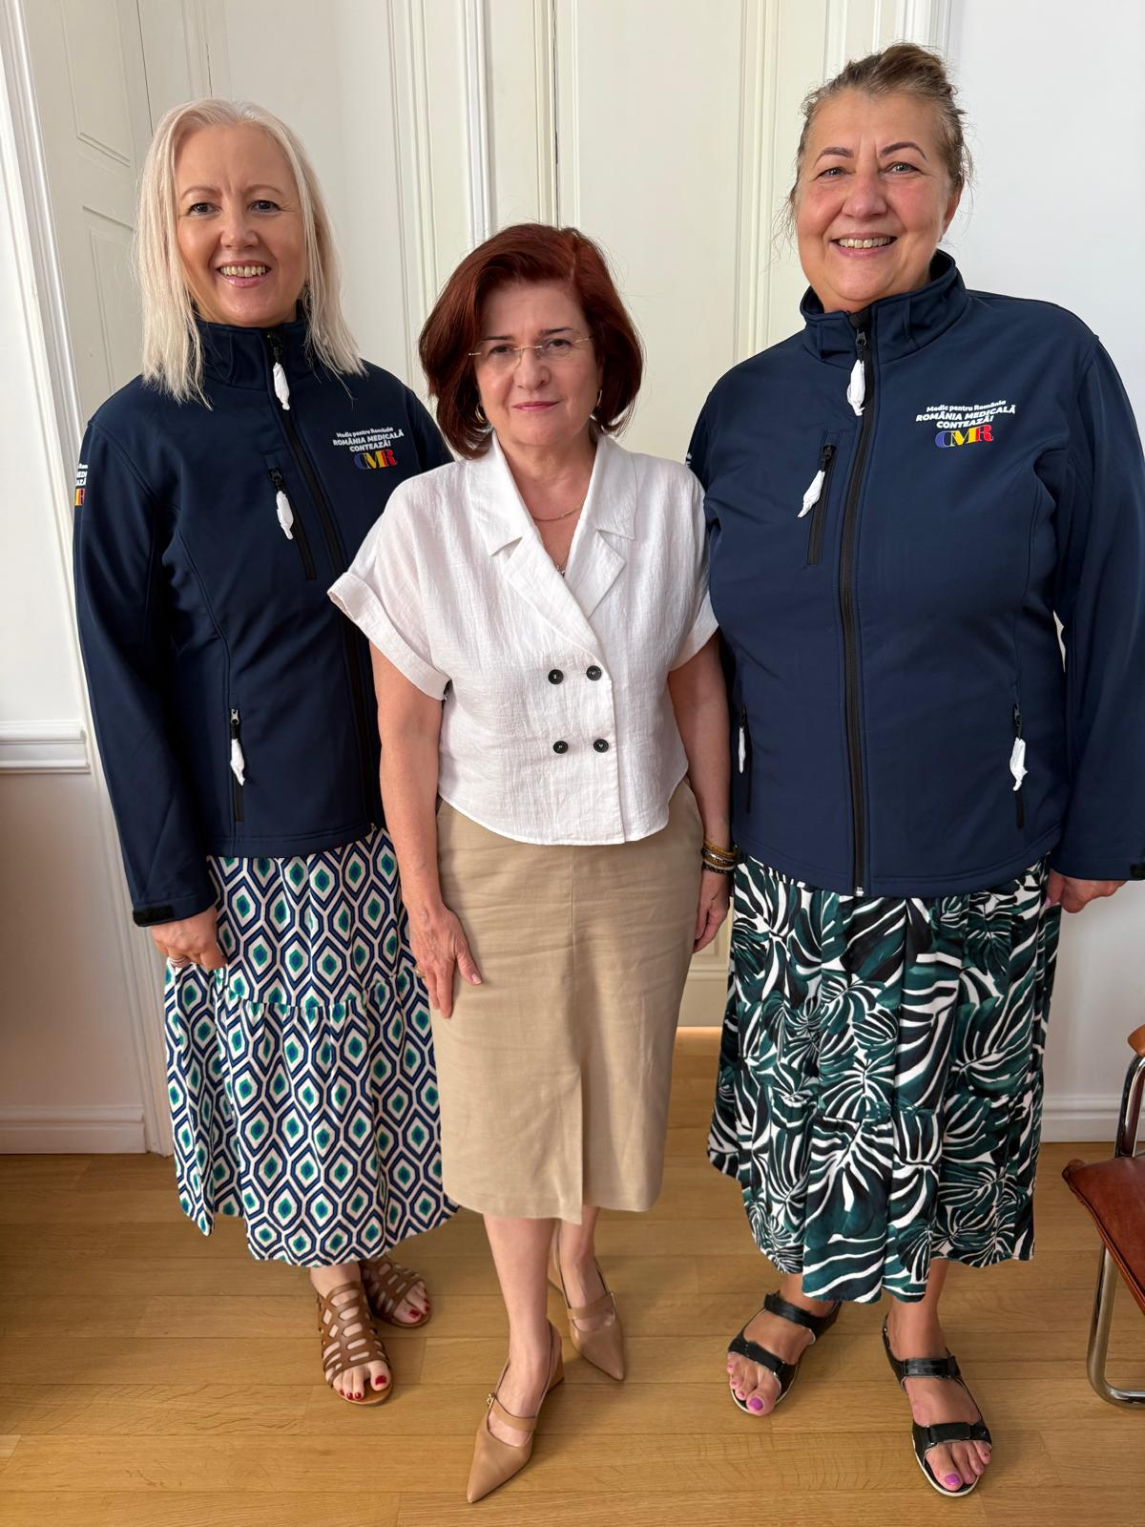
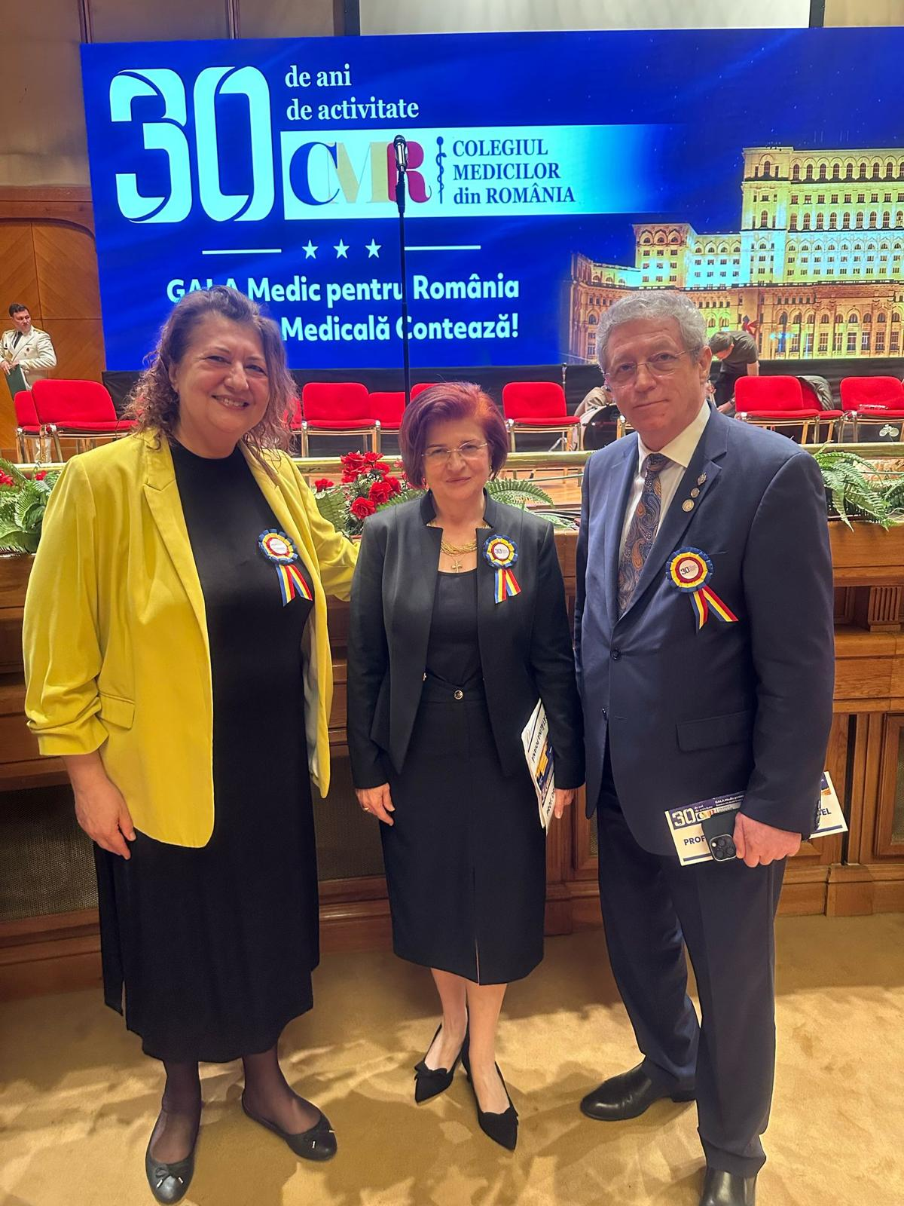

Slide 3
Recognition of foreign diplomas: Which authority in your country is responsible for the recognition of foreign diplomas? Is your medical chamber responsible?
For the recognition of university diplomas issued in other countries, the competent authority in this field is the National Centre for the Recognition and Equivalence of Diplomas (CNRED), which operates as a department within the Ministry of Education.

Slide 4
The procedure for the recognition of a qualification obtained outside the European Union is carried out by the Ministry of Health.
The Romanian College of Physicians is involved in the procedure for the recognition of qualifications obtained in other countries, by issuing an opinion based on the minutes of the Joint Recognition Commissions in which the RCP has 2 members.

Slide 5
Qualifications obtained in the EU are recognized through the automatic mechanism or the general system by the Ministry of Health.
The right to practice is obtained after registration in the Romanian College of Physicians, which in turn is possible only after the equivalence of the university degree by the CNRED and the title of qualification by the Ministry of Health.

Slide 6
THANK YOU FOR YOUR ATTENTION!

