Slide 1


Doctor’s chamber of republic of north Macedonia

Slide 2

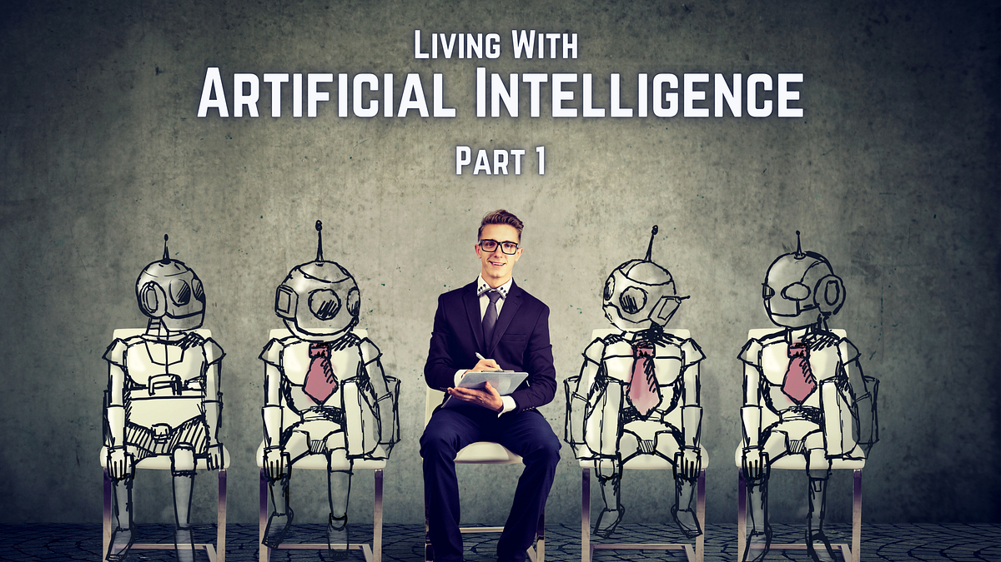
  Artificial intelligence

Slide 3

Does your medical chamber have a developed position on AI?

Slide 4

Within the Chamber, the topic of artificial intelligence (AI) in medicine is still in a developmental phase, and no formal official documents or strategies for its implementation have been adopted so far. However, given the global trends and the existing applications of AI in diagnostics, radiology, and data analysis, it is expected that in the coming years, the Chamber will develop an official position or issue recommendations regarding its use.
At present, the topic is mainly addressed through public debates, academic conferences, and government initiatives aimed at the digitalization of the healthcare system. Particular attention is given to the following aspects:
Ethical considerations – how to ensure the safe, ethical, and responsible use of AI in healthcare;
Legal responsibility – who is accountable in the case of errors arising from the use of AI technologies;
Education and training – the need for healthcare professionals to acquire new knowledge and skills related to AI;
Regulation and standardization – alignment with European directives, particularly regarding the protection of personal health data in accordance with the GDPR.
Although still in its early stages, there is growing awareness of the importance and potential of AI in medicine, creating space for future regulatory and educational initiatives.

Slide 5
Do you inform members about the developments in AI, and if so, how?

Slide 6

Currently, the Medical Chamber of the Republic of North Macedonia does not have an established formal mechanism for regularly informing its members about developments in artificial intelligence (AI) in healthcare.
In comparison to other countries, where dedicated working groups on AI in healthcare exist within medical chambers (such as in Germany, Austria, or the United Kingdom), such a structure has not yet been formed in our country.

Slide 7
Do you anticipate using AI to plan the deployment of medical personnel in your country?

Slide 8
At present, there is no formalized strategy in North Macedonia for using artificial intelligence (AI) in medical workforce planning. However, the topic is becoming increasingly relevant, particularly in the context of physician shortages, migration, and the need for better human resource management in the healthcare sector.
Nevertheless, there are opportunities and ideas for applying AI in this area, such as:
Forecasting workforce needs – AI can analyze demographic data, health indicators, trends in chronic diseases, and migration patterns to predict how many doctors will be needed by region and specialty.
Optimizing allocation – AI systems could propose the most appropriate distribution of medical personnel based on the actual needs of the population.
Scenario simulation – modeling different scenarios (e.g., population aging, increase in certain diseases) and calculating future specialist requirements.
Policy support – AI tools could assist the Ministry of Health in developing strategies for education, specialization, and retention of medical staff.

Slide 9
Are there any plans for your medical chamber to us AI in its work, e.g. in the area of member
administration? Do you already use it?

Slide 10
The Medical Chamber has both interest and plans to integrate artificial intelligence (AI) into its operations, particularly in the area of administrative processes related to its members. Currently, opportunities for applying AI are being explored with the aim of improving efficiency, automating routine tasks, and enhancing the accuracy and security of data.
Although AI has not yet been fully implemented, there are ongoing initiatives to use simpler AI tools, such as automated systems for responding to frequently asked questions, document scanning and processing, and basic data analysis.
At every step, careful attention is paid to the protection of personal data, ethical considerations, and the needs of the members. The goal is to use AI as a support tool for employees, allowing them to dedicate more time to complex tasks and direct communication with physicians.

Slide 11


Slide 12

THANK YOU

