Slide 1
Representing the voice of European Doctors
Dr Péter Álmos, Vice-President
Skopje, North Macedonia

Slide 2


We represent national medical associations across Europe, covering roughly:
1.7 million European Doctors from 37 countries
We are committed to contributing the medical profession’s point of view to EU institutions and European policy-making through pro-active cooperation on a wide range of health and healthcare related issues.
We promote the highest level of medical training and practice but also the provision of evidence-based, ethical and equitable healthcare services.

Slide 3
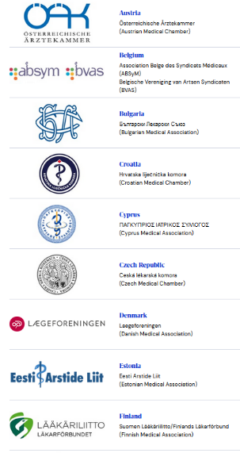
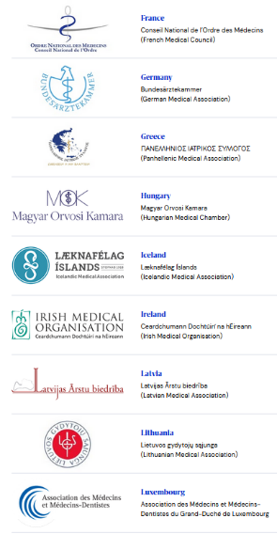
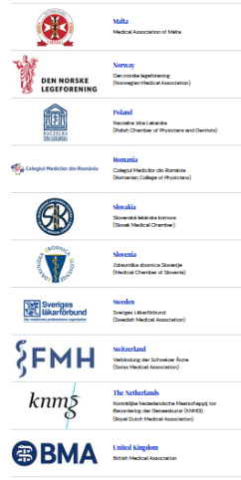
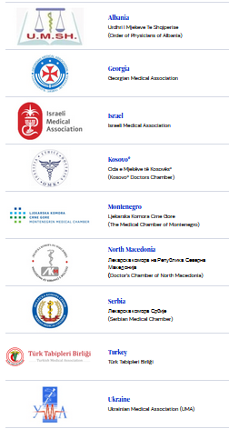
Members

Slide 4
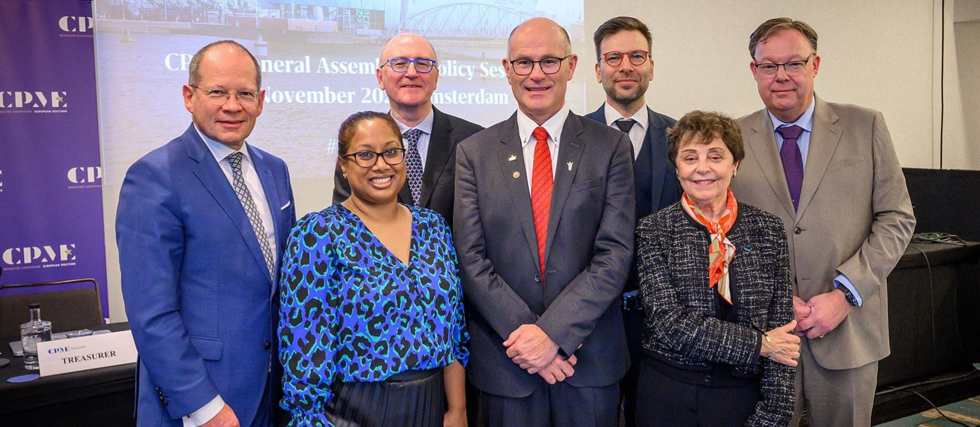
Board of Directors 2025-2027
Dr Andreas Botzlar
Vice-President
Germany
Dr Kitty Mohan
Vice-President
UK
Prof. Dr Ray Walley
Treasurer
Ireland
Dr Ole Johan Bakke
CPME President
Norway
Dr Péter Álmos
Vice-President
Hungary
Dr Jacqueline Rossant-Lumbroso
Vice-President
France
Dr Christiaan Keijzer
Immediate Past President
Netherlands
Notes:
Our new Board was took office in January.

Slide 5

Policy and Priorities 2025-2027
Policy clusters Priorities include
AI, EU Health Data Space, eHealth, Digital Skills, Cybersecurity, Data Protection
Digital Health
Pharmaceuticals & Healthcare Products
Access & Shortages, Falsified Medicines, Medical Devices, Antibiotics, Legislation
Environmental Health, Vaccination, Alcohol & Tobacco Control, Food Systems, Mental Health, Gambling
Public Health
Health workforce, Independence, Professional Qualifications, Health Systems
Professional Practice & Patients’ Rights
Notes:
The new Board presented four policy clusters to the General Assembly and agreed on priorities for action.

Slide 6
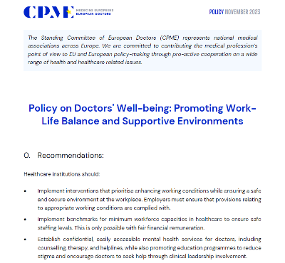

POLICY AGENDA
Professional Practice & Patients’ Rights
Lobbying on European Parliament report on health workforce
Development of policy on optimization of healthcare
Upcoming presentation of results on members' survey on safe staffing
Support to dissemination of results of WHO-Europe survey on doctors’ mental health and well-being
Notes:
- We are preparing a policy which looks at various questions under the umbrella of optimization of healthcare. This can include e.g. task-shifting but also how to avoid low value care.
We have also launched a survey on safe staffing levels and are analysing results to inform future policy discussions. We see that there is increasing debate around this topic and it is important that doctors are part of the discussion.
We also look forward to the WHO-Europe survey collecting data on doctors’ mental health and wellbeing and will be complementing this with our own survey on the activities of the national medical associations which is ongoing.

Slide 7
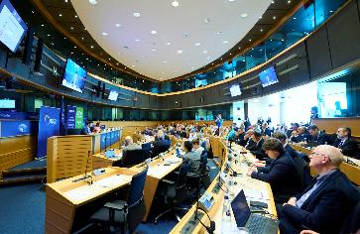
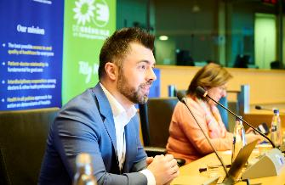
Conference in the European Parliament: Solutions for the European Health Workforce Crisis
On 20 March 2025, doctors from 30 countries contributed to a discussion on sustainable solutions to the European health workforce crisis at an event hosted by MEP Dr András Kulja and MEP Tilly Metz.
The press release on the event is here and the video recording is here.
Notes:
- We are also engaging with the European Parliament on the topic of health workforce. Ahead of our last general assembly in march, we were pleased to bring our members to the European Parliament. Doctors from 30 countries contributed to a discussion on sustainable solutions to the European health workforce crisis. We hope this was a sign how urgent the workforce crisis is and that the videos and stories shared on this occasion will reinforce our call for a European strategy on the health workforce. We now hope that the European Parliament will address our concern in its Report which is currently being drafted.

Slide 8
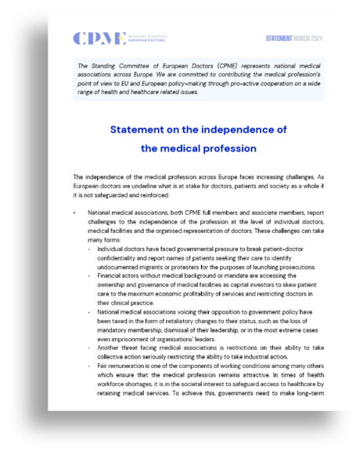
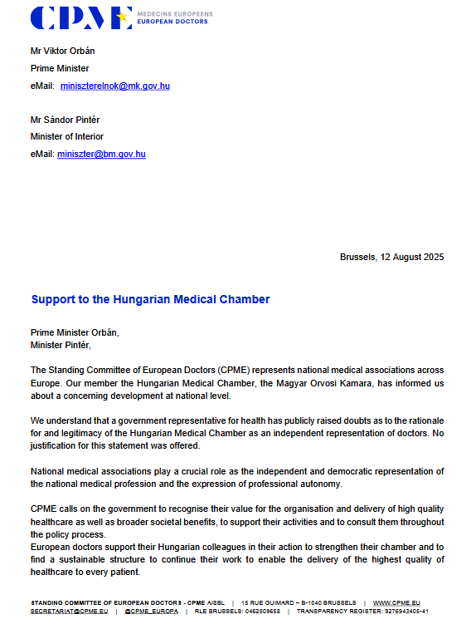
STATEMENT
Independence of
the medical profession
The statement highlights the increasing challenges that the independence of the medical profession faces across Europe, causing a threat to doctors, patients and society.
The existence of robust organisations representing the medical profession strengthens democracy. Independence is key in making patients’ right to health a reality and safeguarding the highest quality of medical practice and autonomy.
Please find the full policy here.
Notes:
We also continuously address the situation of the independence of the medical profession. With recent developments e.g. in Hungary, Albania, UK and Israel which challenge the rights of the profession or the role of the national medical association, we believe it is important to share experiences and use the solidarity among national medical associations to appeal to governments to observe commitments to civil rights, and respect the role of NMAs as civil society actors.
We are raising this issue not only at EU level but also in the Council of Europe and among other partners including other professions some of which are experiencing similar action.

Slide 9
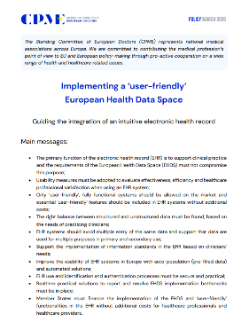
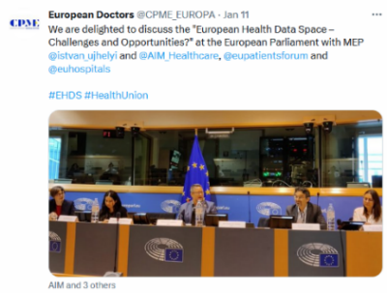
POLICY AGENDA
Digital Health
New CPME policy on Implementing a 'user-friendly' European Health Data Space
  Maintain medical confidentiality and ethics
  Seamless integration with other clinical software
  Call to measure and reduce documentation burden
i2X Project: aims to create exchange format for electronic health records to improve access and interoperability
Notes:
- CPME remains a constructive partner in implementing the EU’s new European Health Data Space which intends to facilitate the exchange of patient data. However, it is important to address confidentiality concerns, as well as the workload and economic burden digital tools place on doctors. Our policy on what doctors believe are ‘user-friendly’ features of EHR systems is currently being presented also in the i2x project which is working on a technical standard for exchanging EHRs

Slide 10

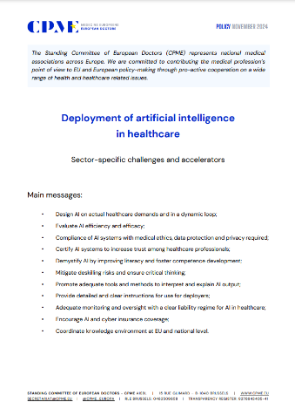
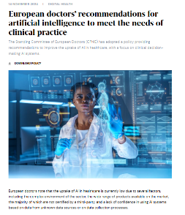
POLICY
Deployment of AI in healthcare: sector specific challenges and accelerators
Focus on clinical decision-making AI systems;
Identifies reasons for low uptake on AI in healthcare and provides recommendations to improve AI uptake.
Key messages include doctors’ right to disagree with an AI system, and to decide on the AI system to use, without repercussions, bearing in mind best interests of the patient
CPME presented its policy on the deployment of AI in different fora, including with European Commission AI Office and the eHealth Stakeholders Group
Please find the full policy here.
Notes:
We also continue our work on AI and are currently focusing on the barriers and opportunities for deploying AI technologies. We are emphasizing the need to gain doctors’ trust and find solutions on training, liability, explainability and integration into workflows.
Our recommendations
Design AI on actual healthcare demands and in dynamic loop
Evaluate AI efficiency and efficacy
Compliance of AI systems with medical ethics, data protection and privacy required
Certify AI systems to increase trust among healthcare professionals
Demystify AI by improving literacy and foster competence development
Mitigate deskilling risks and ensure critical thinking
Promote adequate tools and methods to interpret and explain AI output and provide detailed and clear instructions for use for deployers;
Ensure adequate monitoring and oversight with a clear liability regime
Encourage AI and cyber insurance coverage
Coordinate knowledge environment at EU and national level

Slide 11
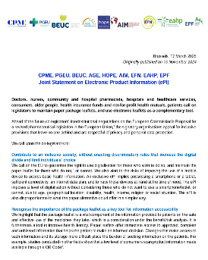
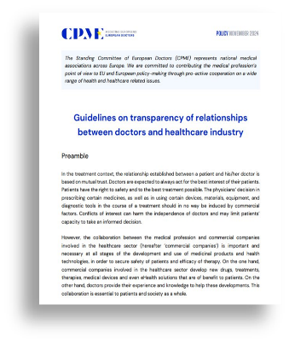
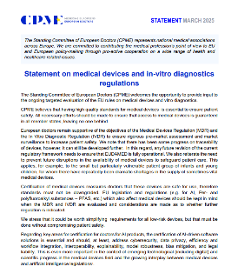
POLICY AGENDA
Pharmaceuticals & Healthcare Products
Continued lobbying with on EU general pharmaceutical legislation
  Position on the Critical Medicine Act
  Joint statement on need to maintain paper leaflets alongside electronic product Information
New statement on medical devices and in-vitro diagnostics, March 2025
  high quality standards for medical devices essential to ensure patient safety
Dissemination of Guidelines on transparency of relationships between doctors and healthcare industry, November 2024
Notes:
- In our work on pharmaceuticals we are concentrating on improving access to medicines for patients in all countries in Europe. We are also looking how to ensure the new EU laws will improve security of supply and prevent shortages of medicines.
- At the March General Assembly, we also adopted a new statement on medical devices that underlines that high quality standards for medical devices is essential to ensure patient safety.

Slide 12
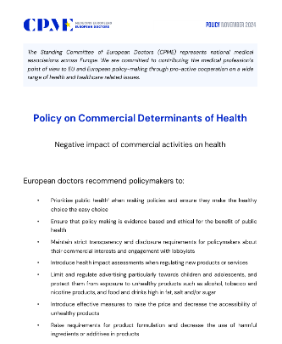

POLICY AGENDA
Public Health
New combined Working Group on Public Health
Development of a new policy on the health effects of gambling
Members’ survey to map on support for the mental health of doctors
Action on clean air and climate change, e.g. through EU Healthy Air Coalition
Co-chairing the Coalition for Vaccination, with a press release for WHO European Immunisation Week
Urging the EU to revise the tobacco control directives
New European Alcohol Health Alliance with WHO/Europe
Notes:
- CPME members decided to merge the three CPME Working Groups on Healthy Living, Vaccination, and Environmental Health & Climate Change into one Working Group on Public Health. The WG decided to start a process to draft a new policy on the health effects of gambling and launch a members’ survey to map how European countries support the mental health of doctors as already mentioned. We will look at both topics at the next GA in October.

Slide 13


MAGAZINE SUMMER 2025
New magazine focuses on health workforce and disease prevention
Editorial from our President, Dr Ole Johan Bakke on investing in health
Feature on conference on health workforce
Presentation of new European Health Alliance on Alcohol and on alcohol control policy in Ireland
Article on why paper package leaflets matter
FEMS guest article on doctors in the digital age: rights, protections and the role of trade unions
Read the magazine here
Notes:
We publish a magazine twice a year and invite you to find the most recent edition online, it also underlines the need to invest in health.

Slide 14
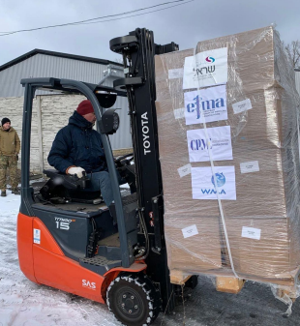
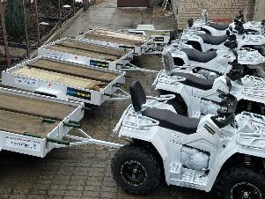
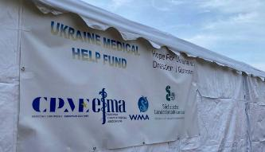



UKRAINE MEDICAL HELP FUND
With WMA and EFMA, around €3 million donated
Major shipments of medicines and medical devices purchased and transported, also including:
Evacuation units (pictured on right)
Tourniquets
Birthing beds
Intensive care materials
Neurosurgical equipment
Warming tents, generators (pictured)
Notes:
We also continue our cooperation with WMA and EFMA to coordinate deliveries of medical equipment and medicines to Ukraine. Recent projects included equipment for transfusion medicine, and evacuation vehicles.

Slide 15
Many thanks for your attention!
For more information, please contact CPME Secretariat:
+32 2 732 72 02 | secretariat@cpme.eu | www.cpme.eu | @ CPME_Europa

