Slide 1

NATIONAL REPORT - HUNGARY
Peter Almos

Slide 2
Artificial intelligence
• Does your medical chamber have a developed position on AI?
No
Do you inform members about the developments in AI, and if so, how?
We are buying an online course
Do you anticipate using AI to plan the deployment of medical personnel in your country?
The government is working on pilot projects in radiology and histology, also on medical data
What role would your medical chamber play in this process?
We are not involved
Are there any plans for your medical chamber to use AI in its work, e.g. in the area of member administration? Do you already use it?
We would like to use it in our app to support decision making (e.g. drug interactions)

Slide 3
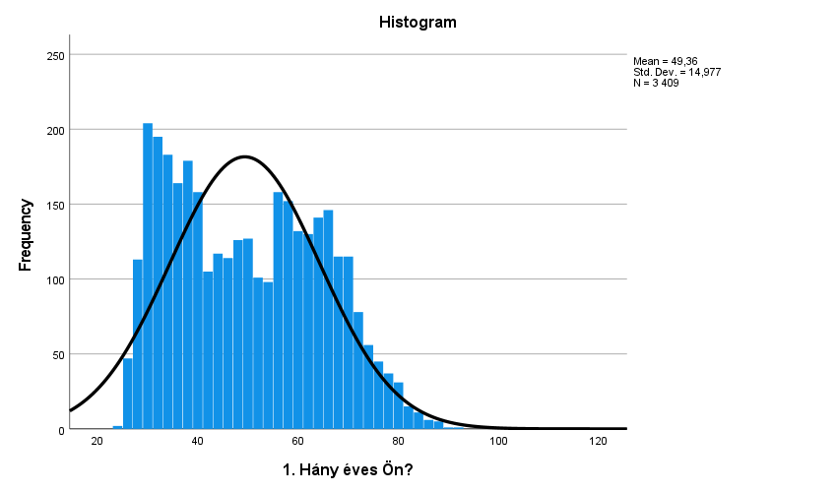
New generations in the medical chambers
What is the age distribution of your members?

Slide 4
New generations in the medical chambers
Do you have any numbers on the age of your medical chamber’s leadership (Executive board, General Assembly etc.)?
Board - 9 members (28, 40, 45, 50, 53, 65, 66, 68)
Are there concepts, either concrete or planned, to encourage young doctors to become involved in the work or bodies/committees of your medical chambers? If so, what are these concepts?
Medical students - associate members, residents: free membership in the first year, reduced membership until specialisation, platforms of communications, residents’ division (1 of 7)
How many young people in your country are interested in studying medicine each year?

Slide 5
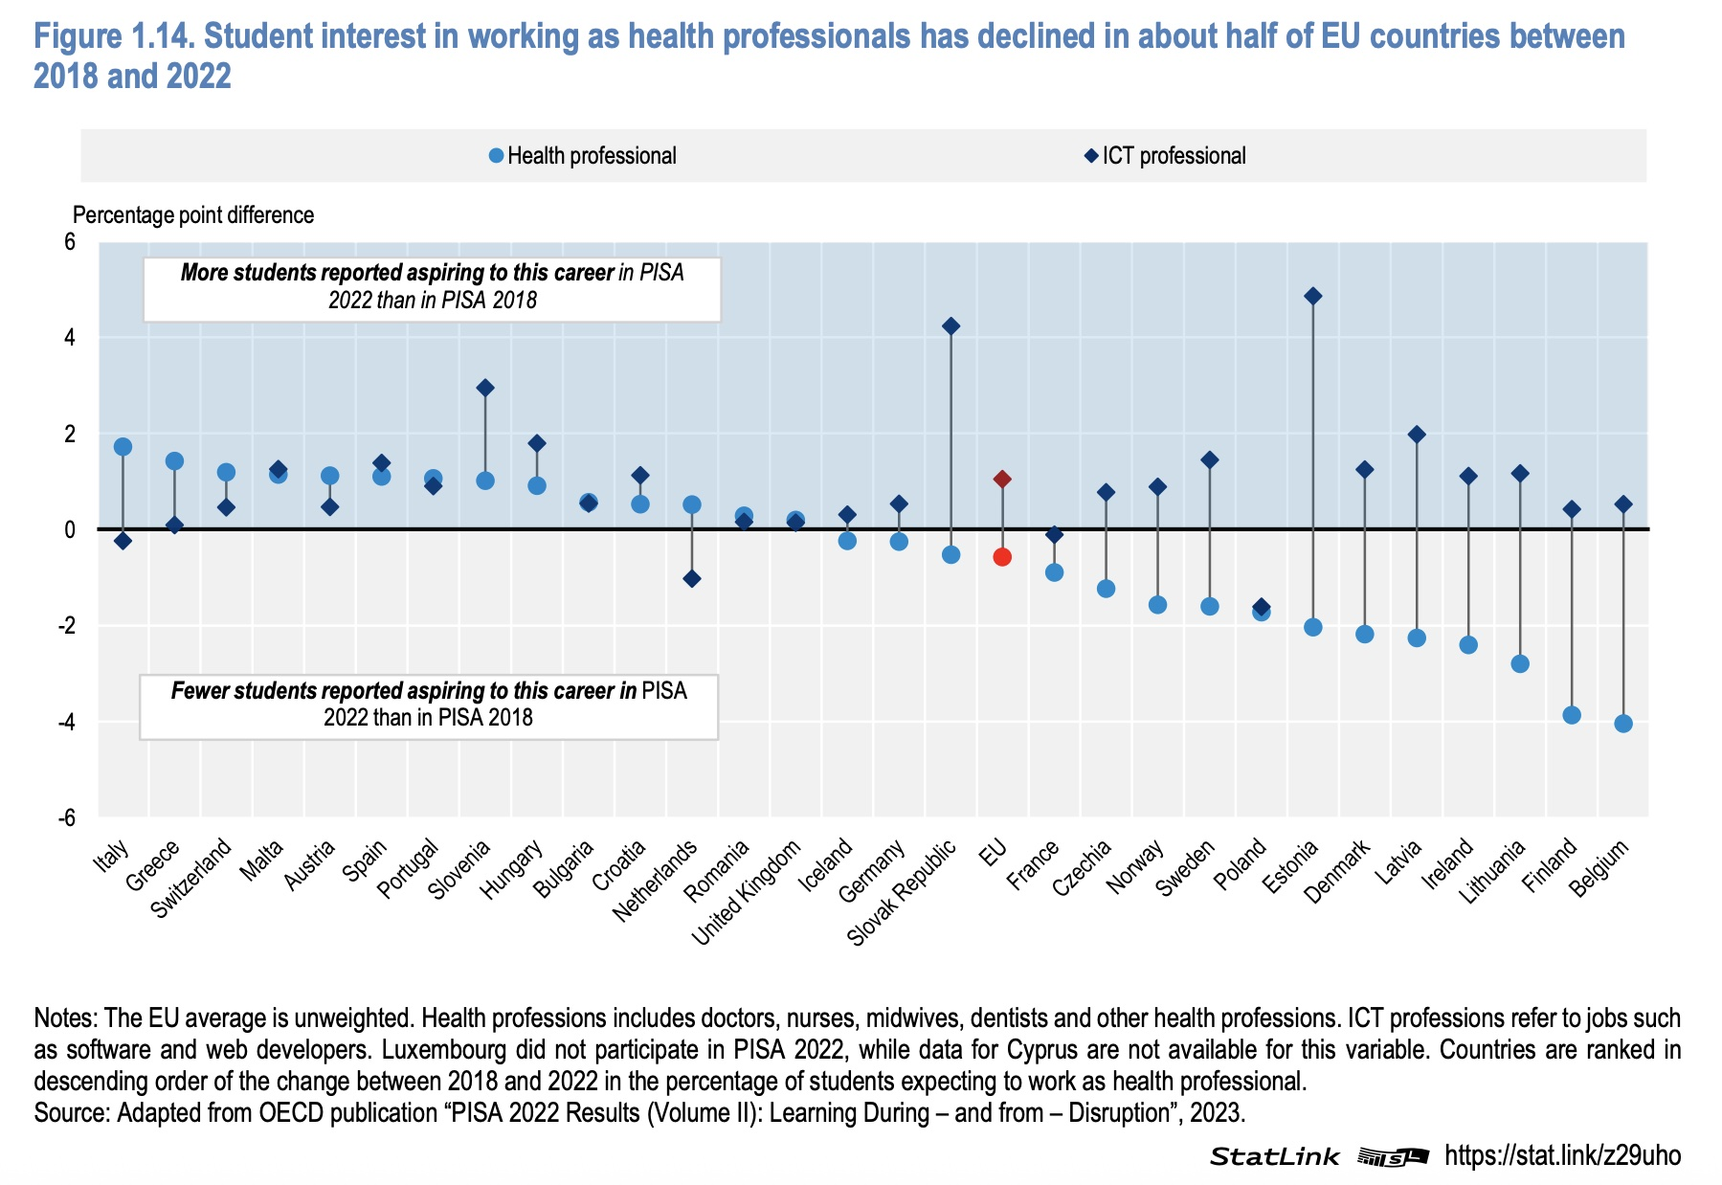
New generations in the medical chambers

Slide 6
New generations in the medical chambers
How many of these individuals end up studying medicine?
1200
What role does your medical chamber play in encouraging young people to study medicine?
Public messages

Slide 7
Involvement in planning of medical personnel
How is the planning of medical personnel organised in your country?
There is no reliable data on number of doctors
Are there any tools which facilitate this organisation? Are there any bodies that include all the relevant stakeholders, besides the government?
No
Is your medical chamber involved in the development of medical personnel?
Occasionally

Slide 8
Thank you!
almos.peter@mok.hu

