Slide 1

National Report Austria
Mag. Katarzyna Bagińska
International Department of the Austrian Medical Chamber
III. Involvement in planning of medical personnel
ZEVA Symposium
Skopje, 4.-6. September 2025

Slide 2
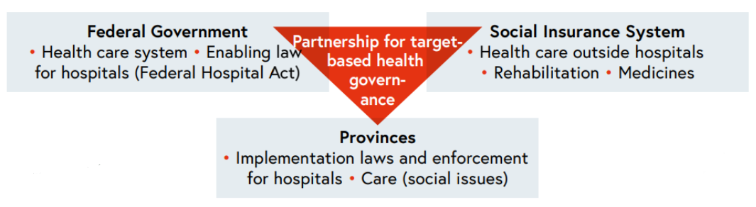
Joint Responsibility for the Health Care System
In Austria, the planning and development of healthcare personnel, especially physicians, occurs through a multi-level, fragmented system.

Slide 3
Federal-Level Framework: Austrian Structural Plan for Healthcare
The central planning instrument at the federal level acts as a framework for integrative health-service planning across Austria and has been in use since 2013 as part of the target-based health governance system.
It is collaboratively developed by the federal government, the provinces, and social health insurance entities.

Slide 4
Regional level
Each of Austria’s nine provinces is responsible for translating the federal framework into Regional Structural Plans for Healthcare (RSG), tailoring the Austrian Health Care Structure Plan’s guidelines to regional specifics.
The Medical Chamber is integrated into the planning process as the representative of physicians.

Slide 5

Physician Workforce Planning
Location-based staffing plans determine how many social health insurance-contracted physicians are permitted in each region and specialty. These plans are negotiated between regional funds and the respective provincial medical chamber.
By law, each insured person should have access to at least two contracted physicians within a reasonable distance.

Slide 6
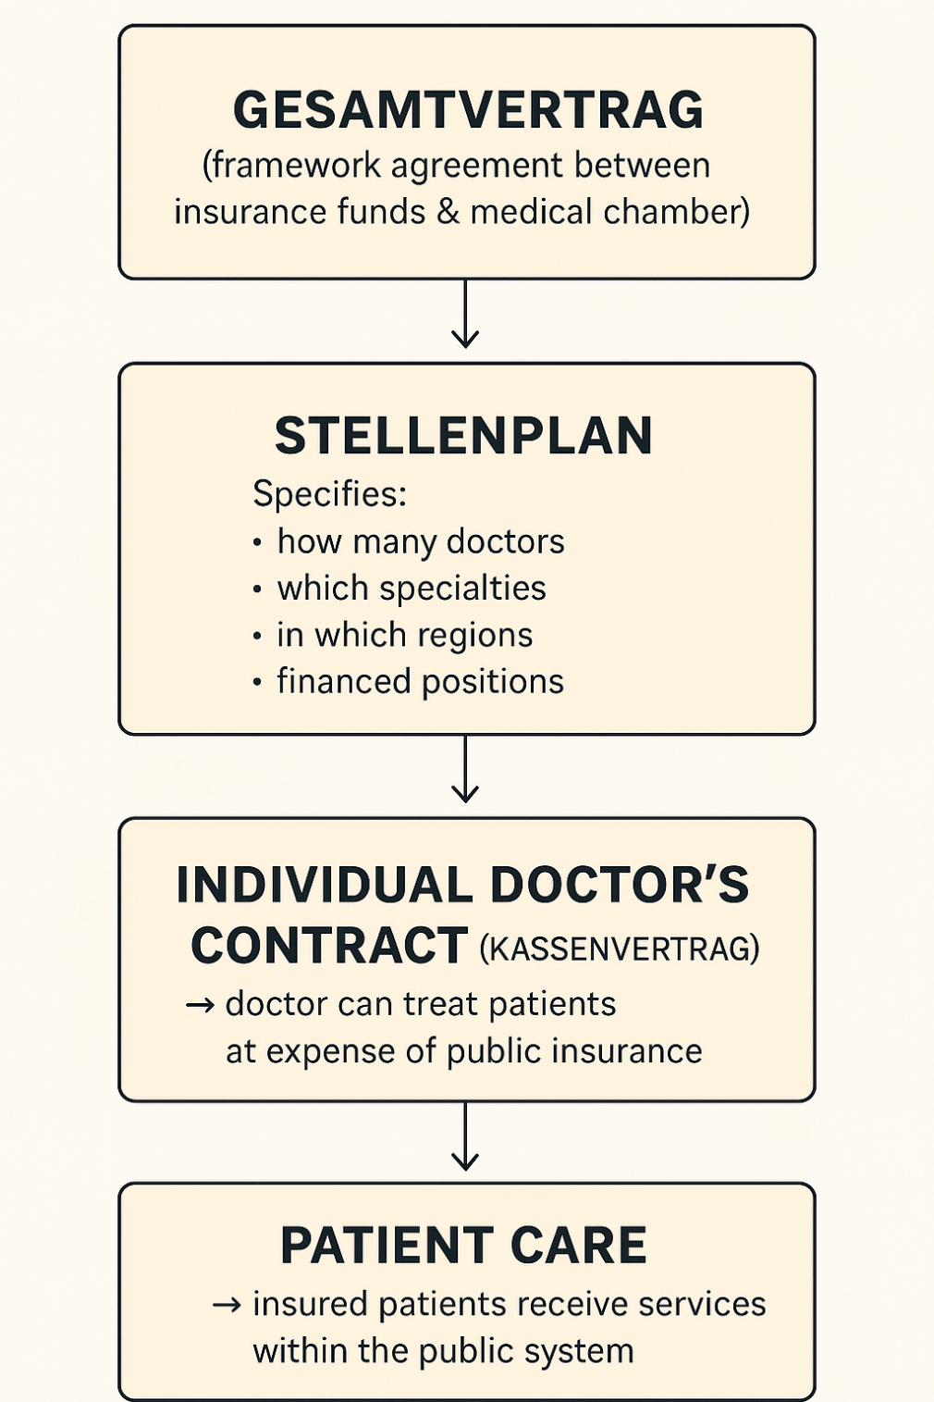

Slide 7
Tariffs and Vacancy Management
The general tariffs for services are negotiated between the different health insurance funds and the provincial medical chamber and apply to all contracted physicians.
This system ensures standardized remuneration for doctors within each province and equal access for insured patients.

Slide 8
The provincial medical chamber publicly advertise Kassenplanstellen (contracted physician positions with health insurance funds), manage application lists, and apply the legally defined “ranking criteria” when nominating candidates to fill posts, so that all eligible physicians have equal opportunity to apply.

Slide 9
Further examples of the ÖÄK involvement in personnel planning
The Austrian Medical Chamber maintains a mandatory national physician register. It contains detailed data on all licensed doctors in Austria: specialty, training status, practice location, employment type, and whether they work as contracted physicians or private doctors. This database provides a real-time overview of physician distribution across specialties and regions, serving as the foundation for workforce planning

Slide 10
The Austrian Medical Chamber regulates postgraduate training frameworks, participates in accreditation procedures of training sites, runs the continuing education programme (DFP), and issues Quality Guidelines for Medical Training.
The ÖÄK also provides statistics and data relevant to personnel planning in the healthcare sector.

Slide 11

The Austrian Medical Chamber acts as the legal representative body of all physicians. It provides advocacy and expertise in discussions on workforce planning with the federal ministry and local governments and comments on planned health reforms.

Slide 12

Thank you for your attention!

