Slide 1

National Report Austria
Mag. Katarzyna Bagińska
International Department of the Austrian Medical Chamber
I. Artificial intelligence
ZEVA Symposium
Skopje, 4.-6. September 2025

Slide 2

Artificial intelligence in Austria
AI Act - European regulation on artificial intelligence came into force on 1 August 2024. Its main purpose is to ensure that AI is developed and used in a safe, trustworthy, and harmonized way across the EU.
AI systems posing high risks to health, safety and fundamental rights are subject to a set of requirements and obligations.

Slide 3

Implementation in Austria
The Austrian Federal Government’s Implementation Plan was presented on 5 November 2024. It supplements and specifies the AI strategy with new implementation measures.
The use of AI should serve the common good.

Slide 4
AI Service Center - central information hub and point of contact for the general public on matters relating to artificial intelligence.
The Federal Ministry of Labour, Social Affairs, Health, Care and Consumer Protection - ministry responsible for establishing a legal framework that promotes the broad and safe use of AI in healthcare, while ensuring data protection and patient safety.

Slide 5

Position of the Austrian Medical Chamber on AI (press statement from 10.10.2024)
The ÖÄK acknowledges the impact that artificial intelligence will have on all areas of our lives – including medicine.
President Steinhart stresses that now more than ever it is crucial for the medical profession to actively shape AI developments in healthcare in order to avoid being overrun by industrial interests.
Dietmar Bayer (President of the Austrian Society for Telemedicine) calls for strict labelling requirements for AI generated medical reports including the use of non removeable watermarks. He considers metadata annotations (as used in smartphones) to be insufficient in the medical field.
Physicians, who must ultimately bear responsibility, should be fully involved in the implementation of new tools and technologies.

Slide 6
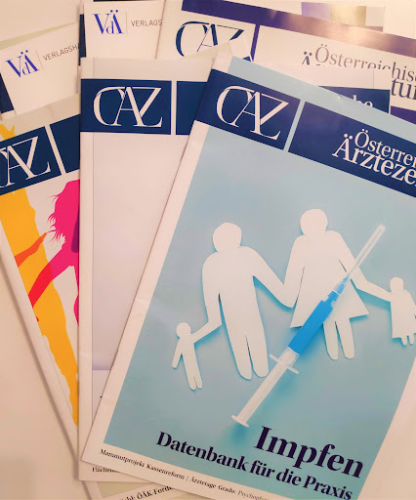
The Austrian Medical Chamber is actively informing members about AI developments via:
Journal - within its Ärztezeitung (Doctors’ Newspaper), ensures that members receive regular, accessible articles on how these technologies influence both clinical practice and medical ethics.

Slide 7

Events - symposium of the Styrian Medical Chamber in March 2025, focused on personalized medicine and AI, discussing innovations like ChatGPT and other AI tools in clinical processes.
Virtual conferences like KI-MED in February 2025, with expert-led sessions on AI in diagnostics, dermatology, cardiology, data privacy.

Slide 8
In August 2025, the ÖÄK conducted a survey on the use of AI by its employees.
Almost two-thirds of them reported that they already use AI tools in their daily professional work.
According to the results, AI is used most frequently for translations, as well as for quick research and summaries. Text checking, as well as the actual generation of texts or images, plays a smaller role.
The most widely used tools are ChatGPT and Google Translate, each employed by nearly one-third of AI users.

Slide 9

The ÖÄK is also currently revising its internal guidelines for AI usage.
At present, there is no AI tool available for the Chamber’s member administration processes.

Slide 10

Thank you for your attention!

