Slide 1
New Generation in Order of Physicians of Albania
Dr.Dritan Trepça
President of OPA
Dr.Fatmir Brahimaj
Vice president of OPA
ZEVA Symposium
4-6 September 2025
Skopje

Slide 2
New generation in Order of Physicians of Albania
Register of membership is over 7000 doctors.
But we do not cancel (remove) from register:
doctors who have migrated
retired doctors (some continue in private practice)
doctors who have died

Slide 3

Age | Number
up to 30 years | 101
31- 40 years | 818
41-50 years | 1187
51-60 years | 1533
61-70 years | 723
over 70 years | 859

Slide 4
In those that are active in Albania we see:
The average age is 50 years old.
The average age of active doctors is growing:
Increasing of retirement age (62 women; 65 for men)
Working beyond retirement age (economic conditions, the health service needs)
Migration of doctors (mostly young ones)

Slide 5
Age distribution to elected doctors in:
Age | nr.
36-40 years | 4
41-45 years | 4
46-50 years | 3
51-55 years | 16
56-60 years | 19
61-65 years | 9
66-70 years | 6
over 70 years | 1
Average age | 55.83 years

Slide 6
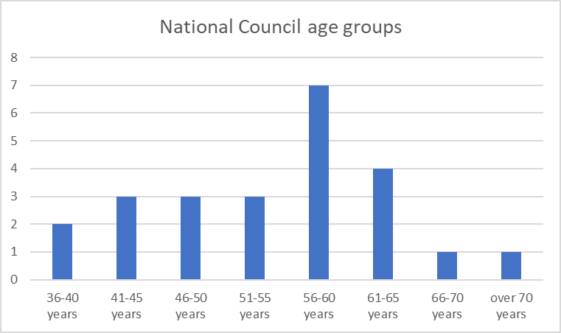
National council age groups
Age | Nr.
36-40 years | 2
41-45 years | 3
46-50 years | 3
51-55 years | 3
56-60 years | 7
61-65 years | 4
66-70 years | 1
over 70 years | 1
Avarage age | 55.125 year

Slide 7
In our medical leadership dominate advanced ages. There are some reasons for it:
To be elected in regional council is necessary to have 10 years of medical practice.
In national council 15 years of practice
OPA is a novelty in Albanian health system. Just for that often are re-elected peoples that were evolved before in OPA structure (they save the experiences and continuity)
We try to involve young doctors in our activities, working groups etc.

Slide 8
Studying medicine in Albania it remain the most preferable profession.
2 universities :
Public : 260 students
240 end up (regular term)
In the last 3 years : 500 students (they have to work at least 3 years in our country)
Private: 70 students (This year will be a new way)
30 that ends up are Albanians that stay in Albanian health service

Slide 9
As conclusion
Based on all this, is clear that we have to work more with young generation of membership.

Slide 10
Thank you!

